Slide 1
Search films
Films Genres Actors Directors
Login
Sign-Up
Film Description Release Date Rating Genre
Brave text here 13/07/2017 7/10 Family
(film cover)
Mean Girls text here 05/12/2009 9/10 Teen Comedy
(film cover)
Get Out text here 20/11/2017 8/10 Thriller
(film cover)
Notes:
Main Page

Slide 2
Search films
Films Genres Actors Directors
Login
User ID/Email:
Password:
Notes:
Login Page (for Admin and User?)

Slide 3
Search films
Films Genres Actors Directors
Sign-Up
First Name:
Last Name:
Email:
User ID:
Password:
Phone No:
Notes:
Sign – up page

Slide 4
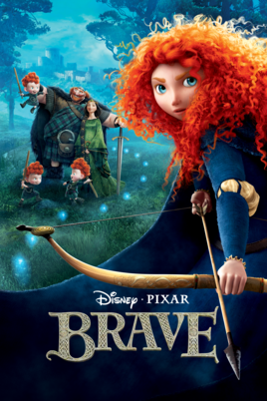
Search films
Films Genres Actors Directors
Log out
Film Name
Film Description
Rating:
Genre:
Release Date:
(Film Name)
Add Gossip Page
Cancel
Notes:
Add Film Description Page

Slide 5
Search films
Films Genres Actors Directors
Log out
Brave Gossip:
Guys they broke the box office records! Lol Here’s the link:
http etc.
That’s cos everyone's watched it at least twice now blah blah blah
(Film Name)
New gossip
Cancel
Notes:
Add Gossip page

Slide 6
Search films
Films Genres Actors Directors
Log out
Review Title
Tag Genre
Review Description
Date Added
(Film Name)
08/03/2019
OK
Cancel
Notes:
Add Review Page

Slide 7

Search films
Films Genres Actors Directors
Log out
Comments:
Fantastic actor
Great actor, good film, nice casting…
Lame…
So boring…
My kid loved her!
Really enjoyed the character…
Cool kids cast
My kid is dressing up as Brave for Halloween
Recommended, great cast
Nice CGI blah…
Actor/Director:
(Actor First Name + Last Name)
(DOB)
(Gender)
Add comment
Cancel
Notes:
List comments (for specific actor/director) page

Slide 8
Search films
Films Genres Actors Directors
Log out
Comment
Date Added
Actor/Director:
08/03/2019
(Actor First Name + Last Name)
(DOB)
(Gender)
OK
Cancel
Notes:
Add comment page

Slide 9
Search films
Films Genres Actors Directors
Log out
Reply Comment
My kid loved her!
Really enjoyed the character…
(Reply comment)
Actor/Director:
(Actor First Name + Last Name)
(DOB)
(Gender)
Date Added
08/03/2019
OK
Cancel
Notes:
Add comment page

Slide 10
Search films
Films Genres Actors Directors
Log out
Select Review to read
Reviews:
Fantastic film
Great film, good acting, nice visuals…
Lame…
So boring…
My kid loved it!
Really enjoyed this one…
Cool kids movie
My kid went to see it twice now
Recommended, great film
Nice CGI blah…
(Film Name)
Cancel
Notes:
List Review (for specific film) page

